Slide 1
Multiple importance reweighting for path guiding
Zhimin Fan¹ Yiming Wang¹ Chenxi Zhou¹
Ling-Qi Yan² Yanwen Guo¹ Jie Guo¹
¹Nanjing University ²University of California, Santa Barbara

Slide 2
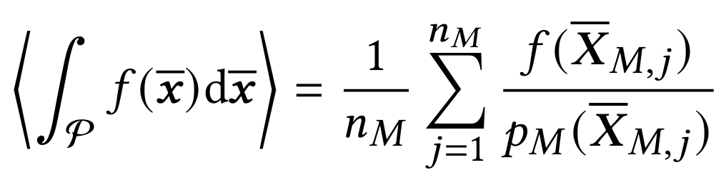
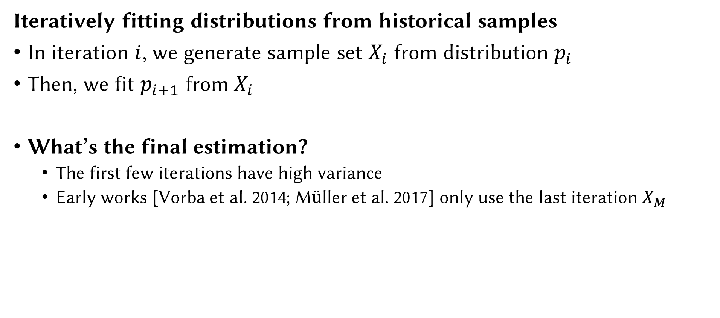
Background: Path Guiding
Iteratively fitting distributions from historical samples
In iteration $i$, we generate sample set $X_{i}$ from distribution $p_{i}$
Then, we fit $p_{i+1}$ from $X_{i}$
What’s the final estimation?
The first few iterations have high variance
Early works [Vorba et al. 2014; Müller et al. 2017] only use the last iteration $X_{M}$

Slide 3
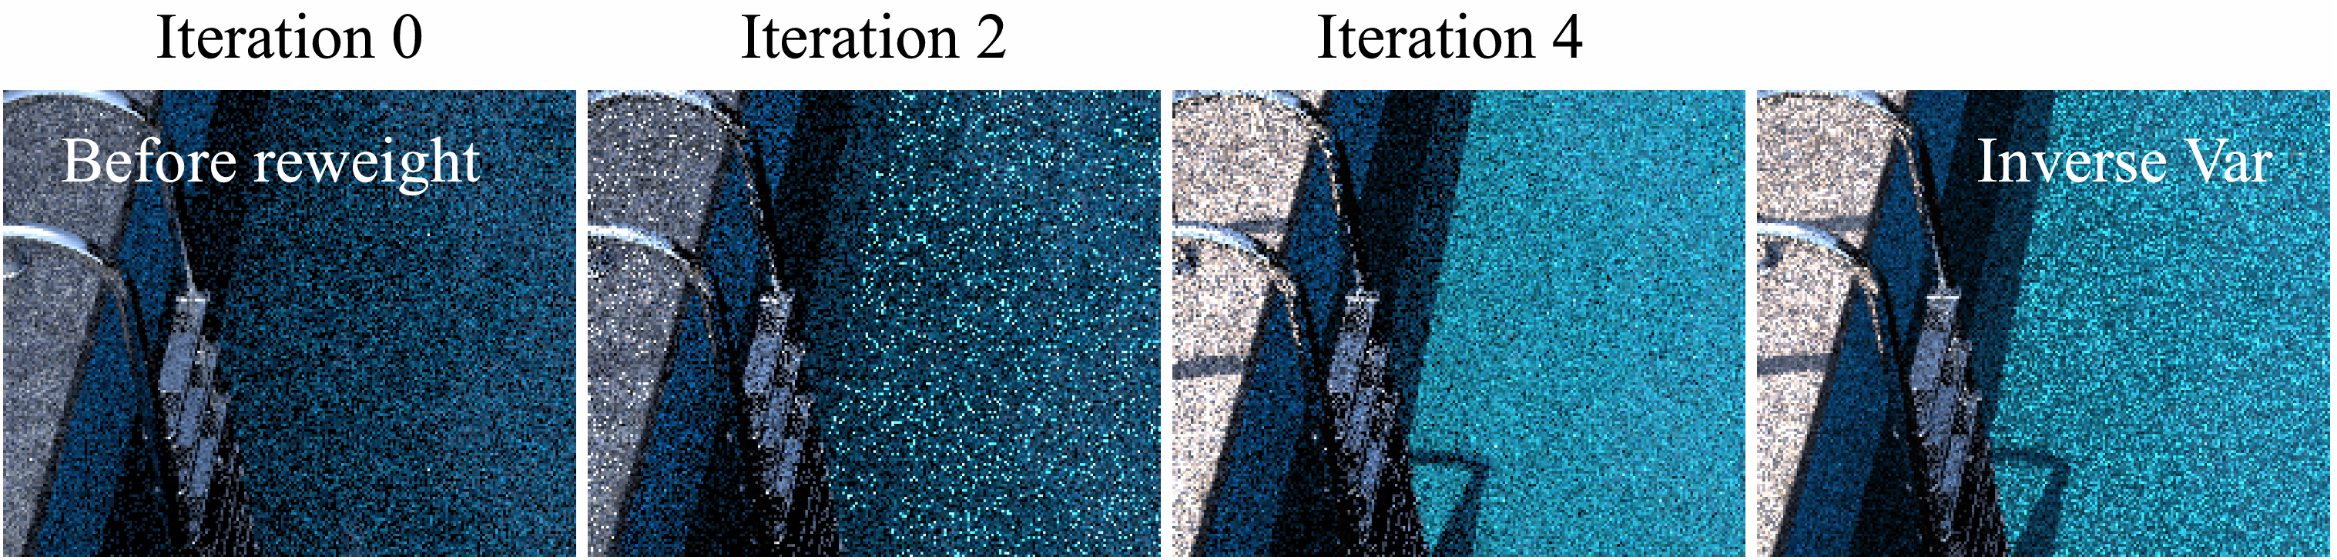
Problem
Each iteration generates a (noisy) image
How to combine these image samples?

Slide 4
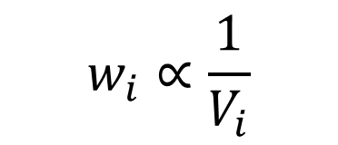
Prior work: inverse-variance weighting
Averaged per image to decorrelate [Müller et al. 2019]
Not using distribution information
May introduce fireflies from early iterations
$$w_{i}∝\frac{1}{V_{i}}$$

Slide 5
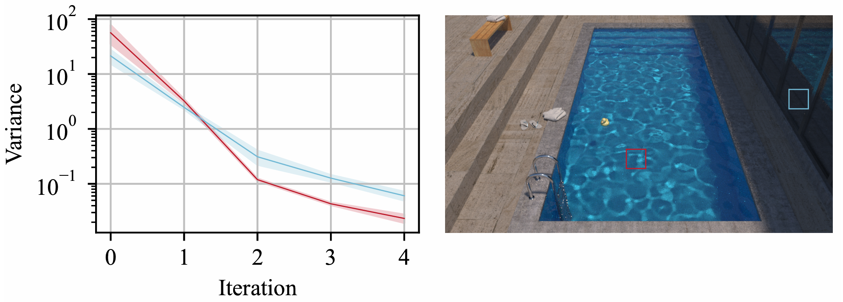
Motivation
Variance changes differ across regions (image space)

Slide 6
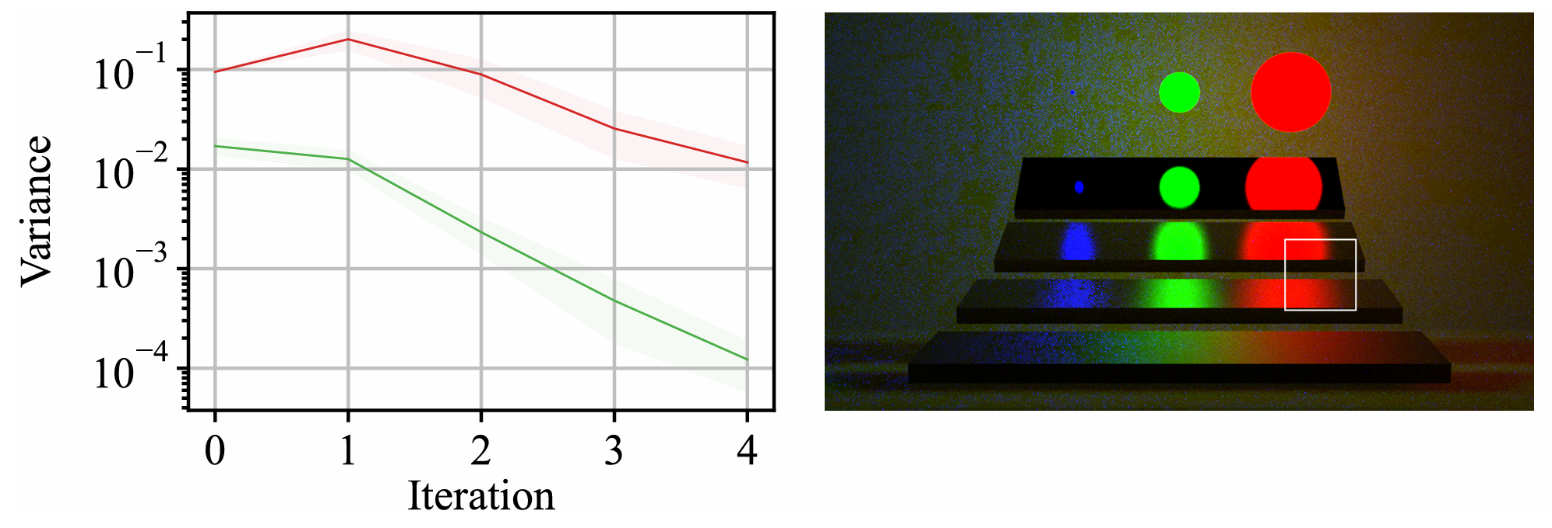
Motivation
Variance changes differ across regions (path space)

Slide 7
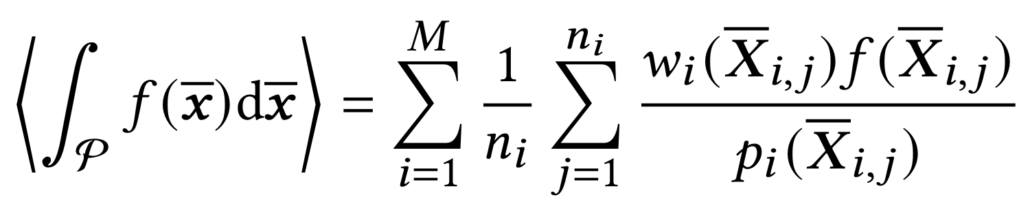
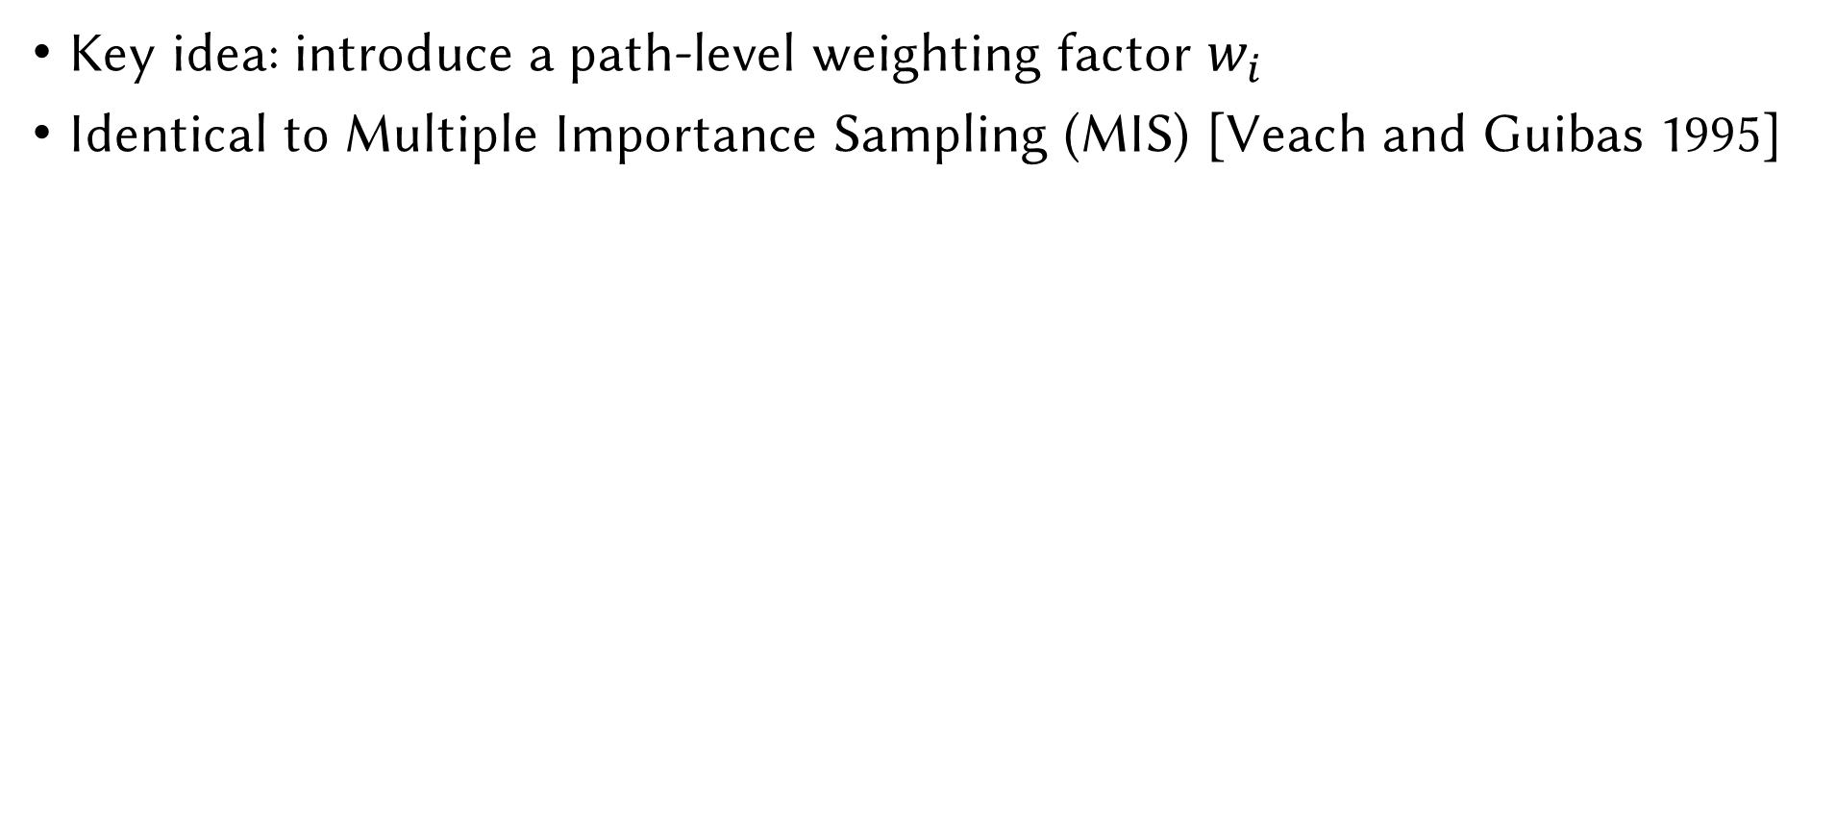
Formulation
Key idea: introduce a path-level weighting factor $w_{i}$
Identical to Multiple Importance Sampling (MIS) [Veach and Guibas 1995]

Slide 8
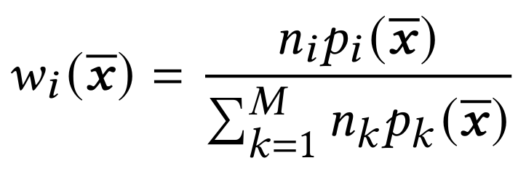
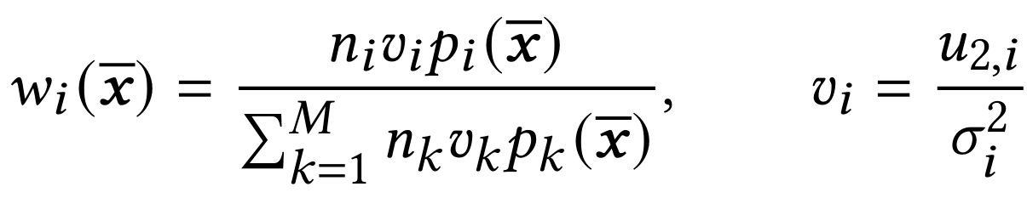
Choice of weights
Balanced-heuristic [Veach and Guibas 1995]
~Adaptive Multiple Importance Sampling [Corneut et al. 2012] in statistics
Provable consistency (under conditions)
Variance-aware [Grittmann et al. 2019]
Difference not evident

Slide 9
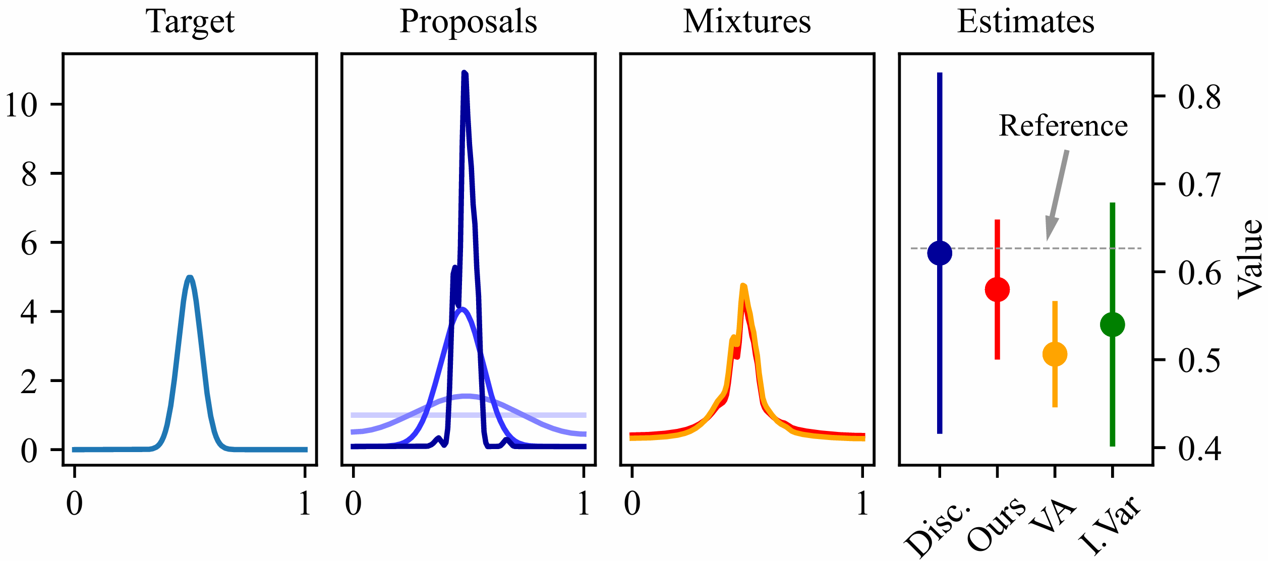
1D example

Slide 10
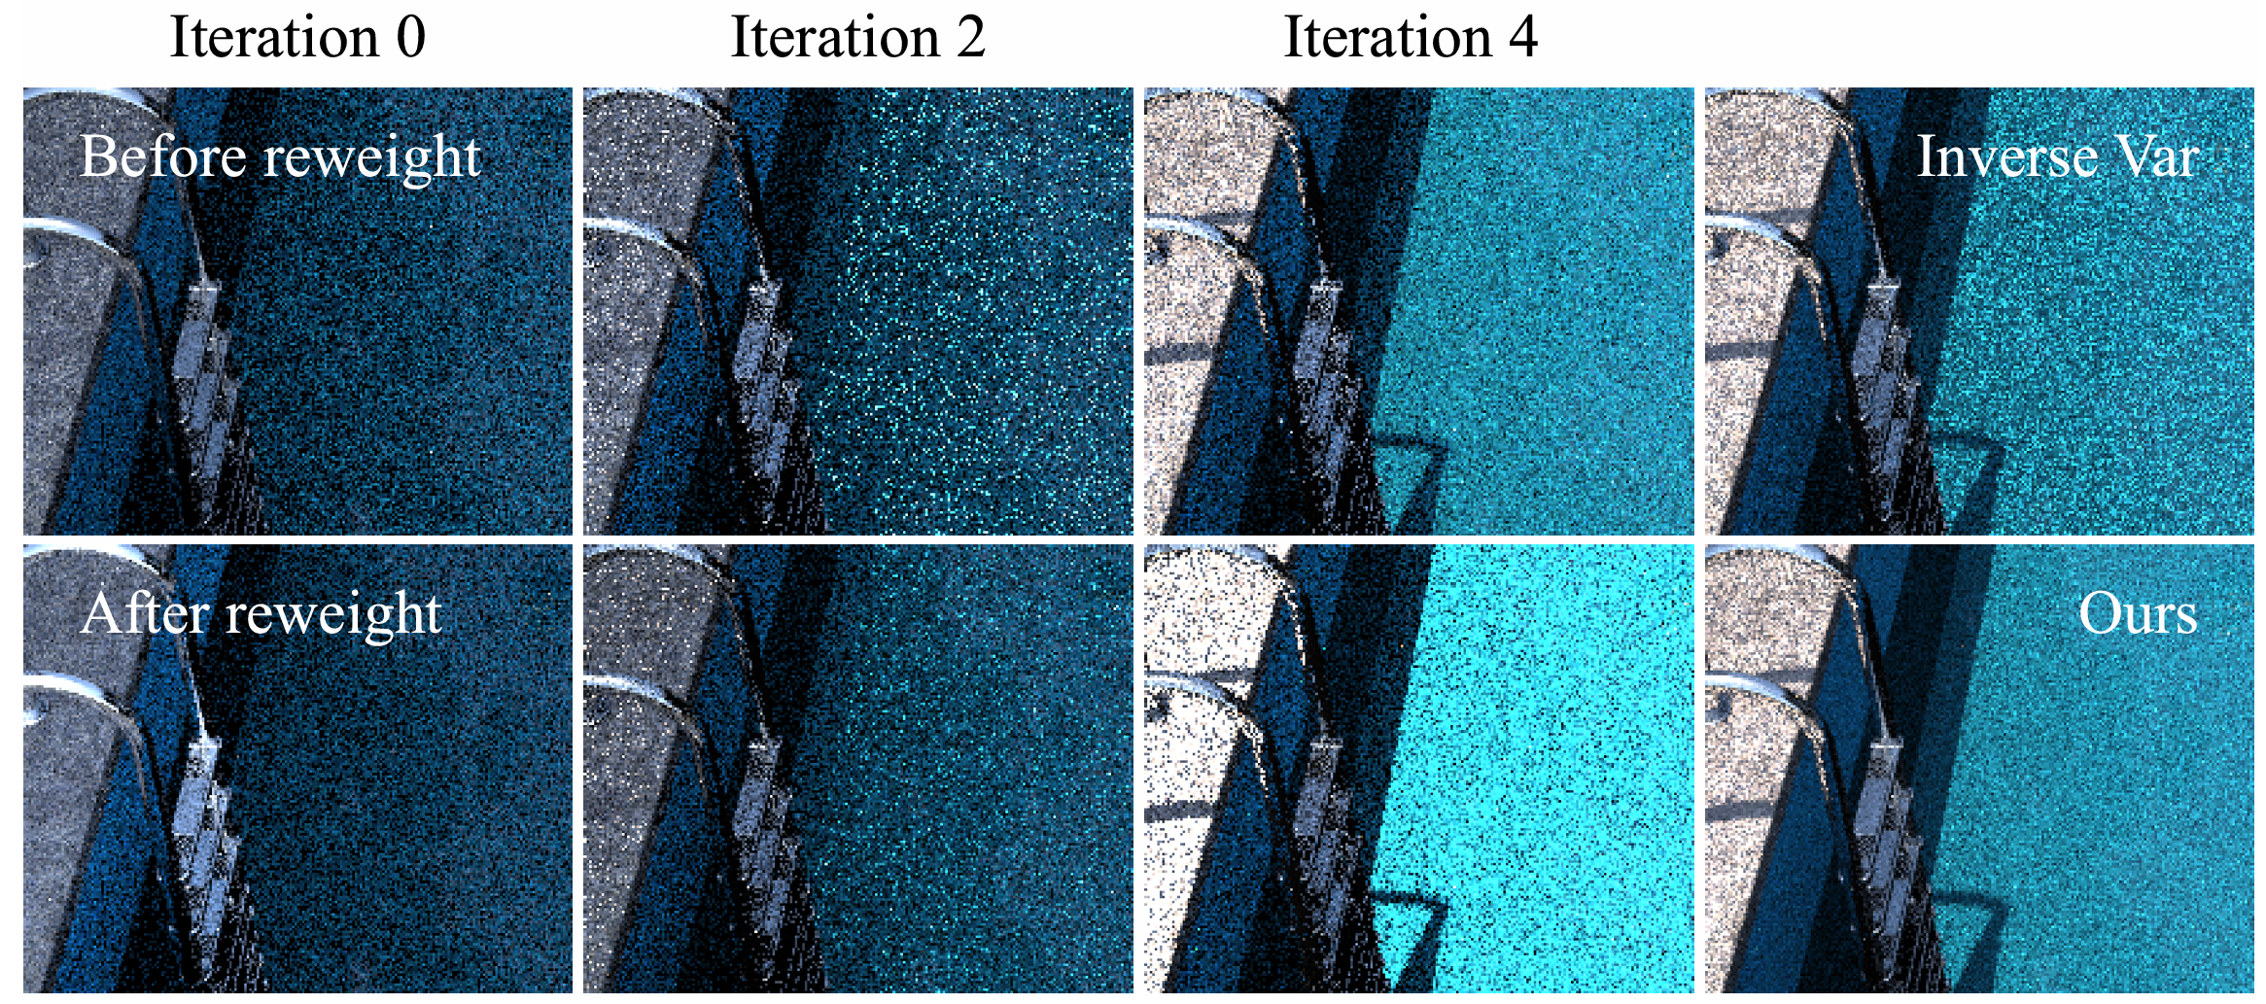
Behavior
Weight up well-fit regions and vice versa

Slide 11
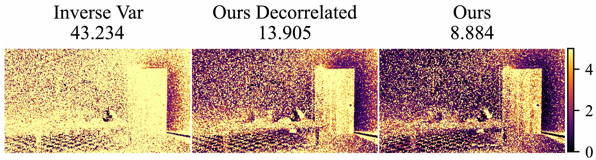
Decorrelation validation
A proof-in-concept experiment
Splat half of the samples to the image and half to the distribution
Keep most of the variance reduction

Slide 12
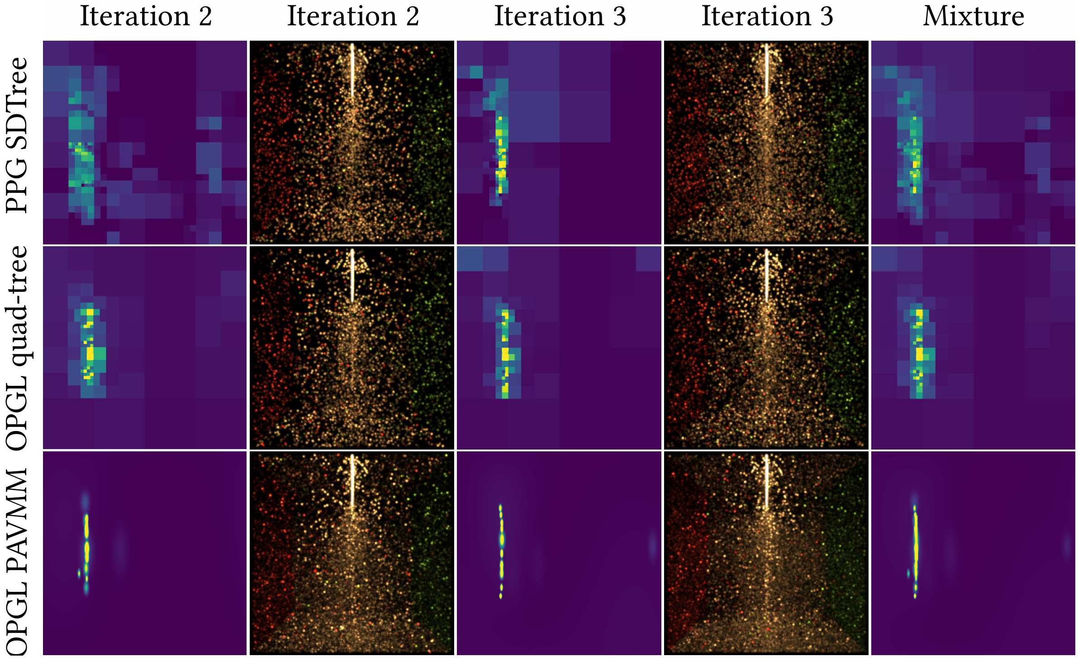
Explanation of benefits
A mixture distribution is more conservative

Slide 13
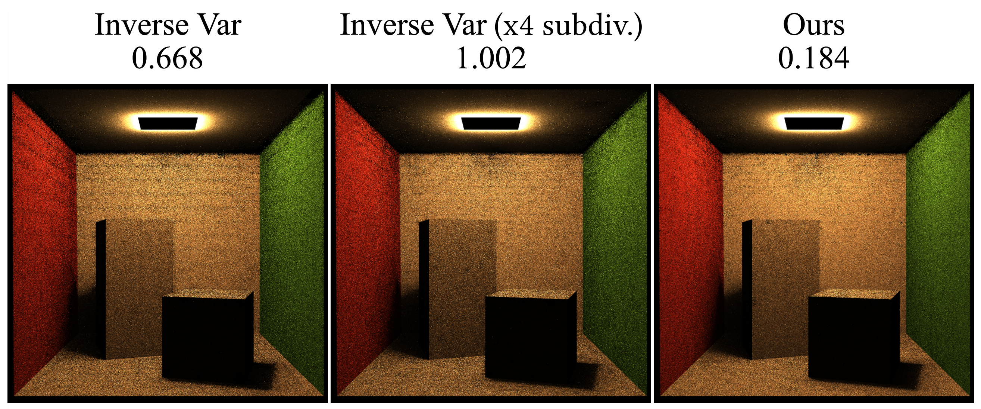
Variance reduction potential: finer division
Since the mixture is more conservative
We can use finer subdivision both spatially and across iterations

Slide 14
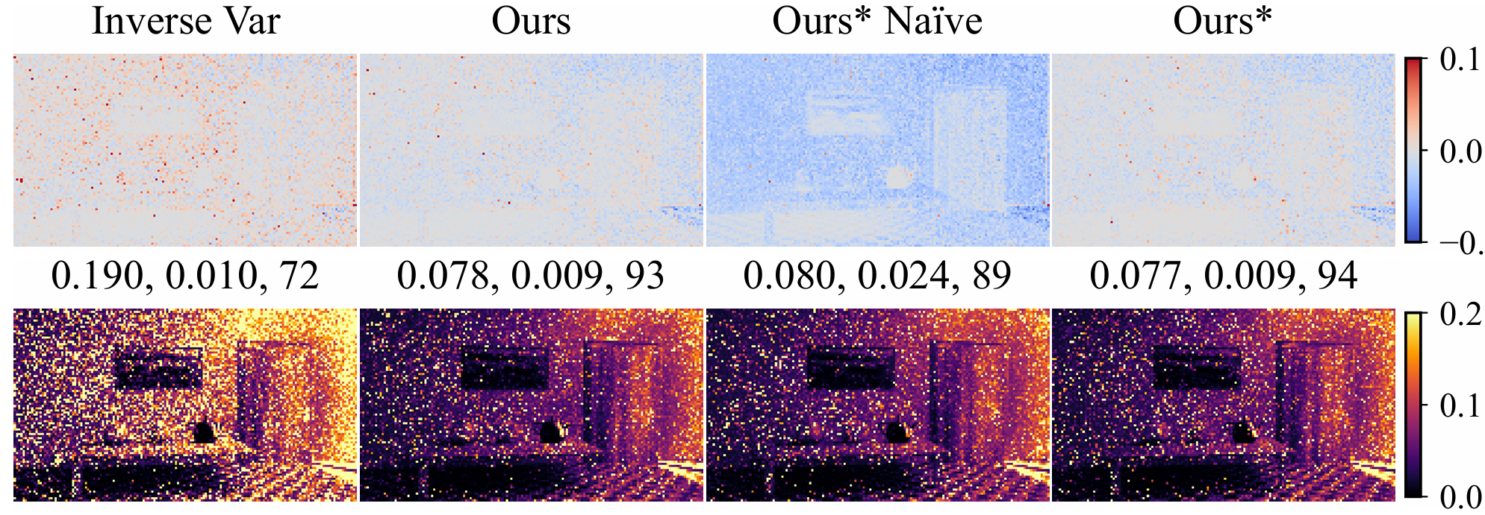
Variant with constant sample storage
Storing all path samples is expensive (Ours)
We keep a fixed-size buffer and throw away low-weight ones
When throwing, reweight it using the partial mixture
Maintain similar variance and bias in many cases (Ours*)

Slide 15
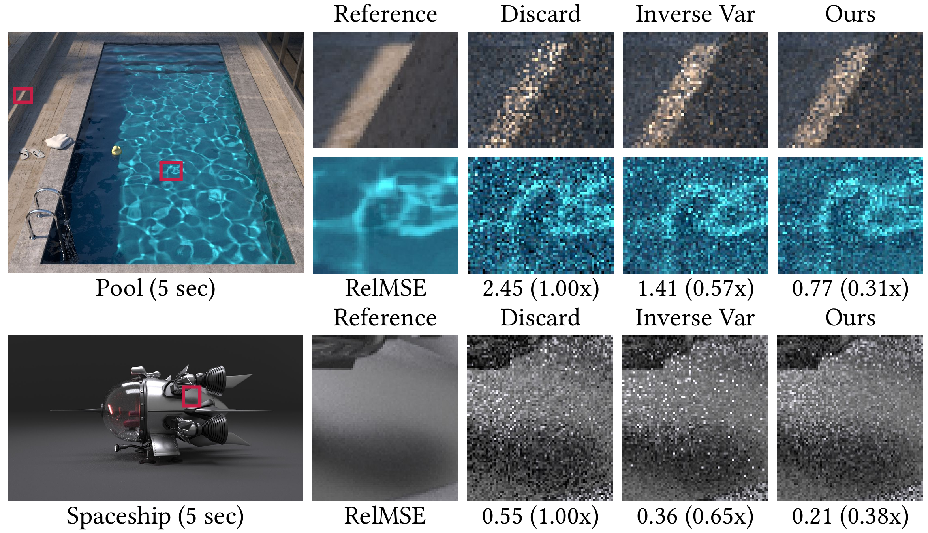

Slide 16
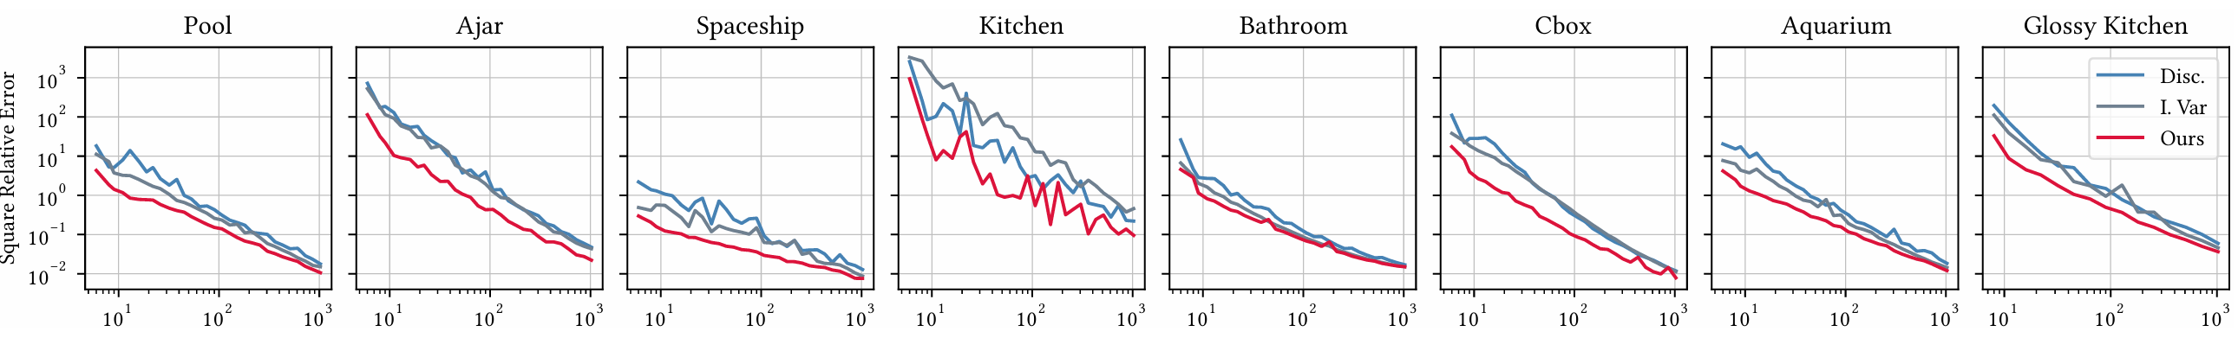
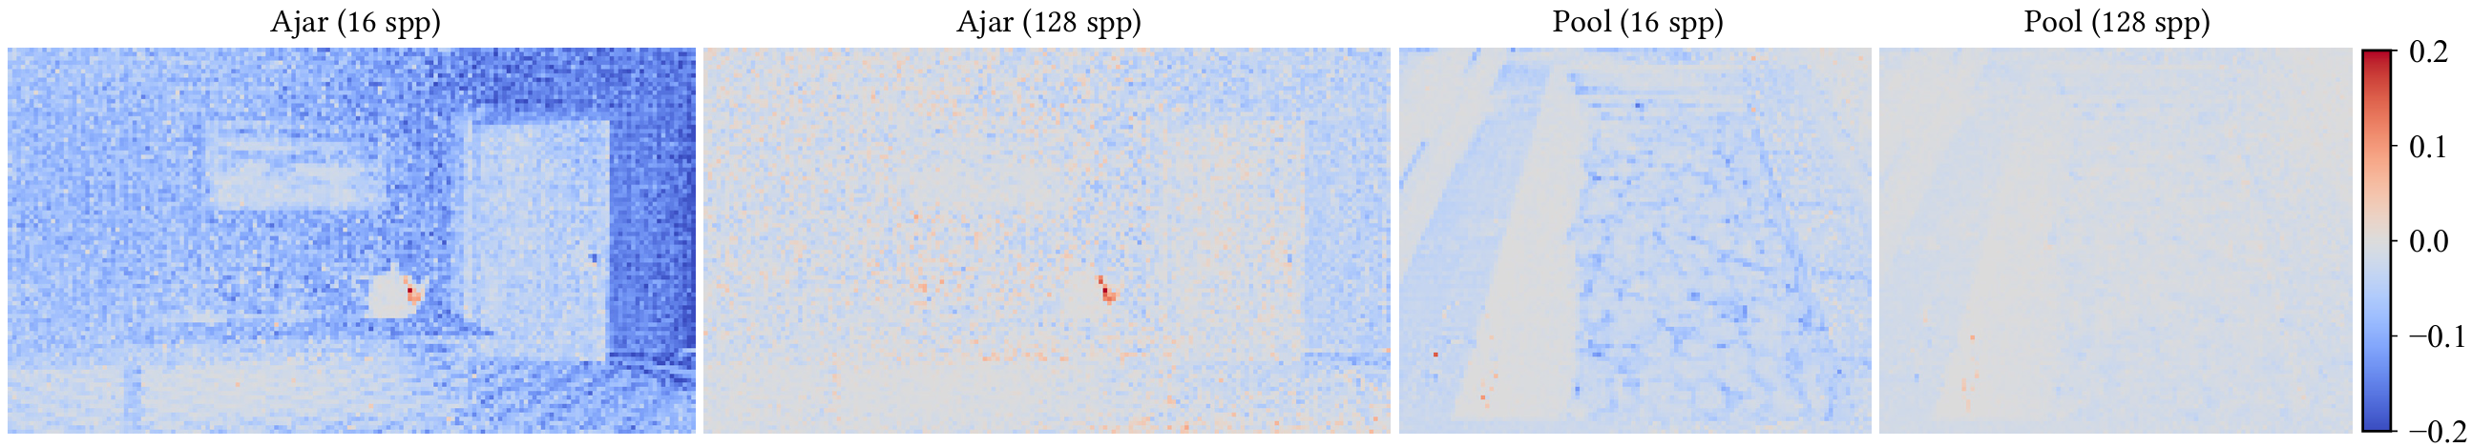
Convergence

Slide 17
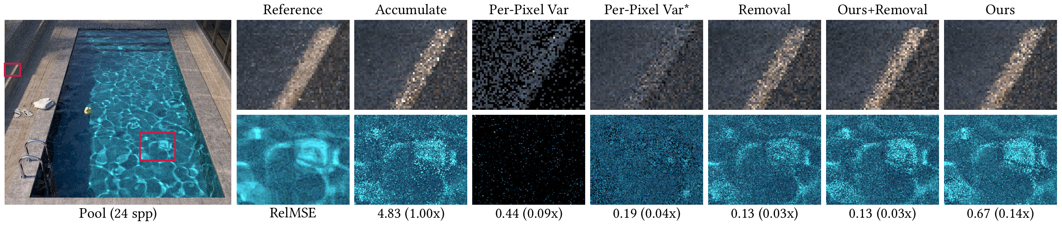
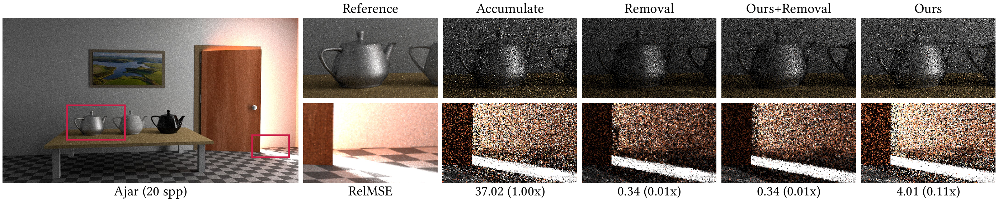
Comparison to firefly removal

Slide 18
Limitations
storage and computation cost
reweighting during training
advanced sampling techniques (e.g., NEE)
advanced distribution representations (e.g., neural)

Slide 19
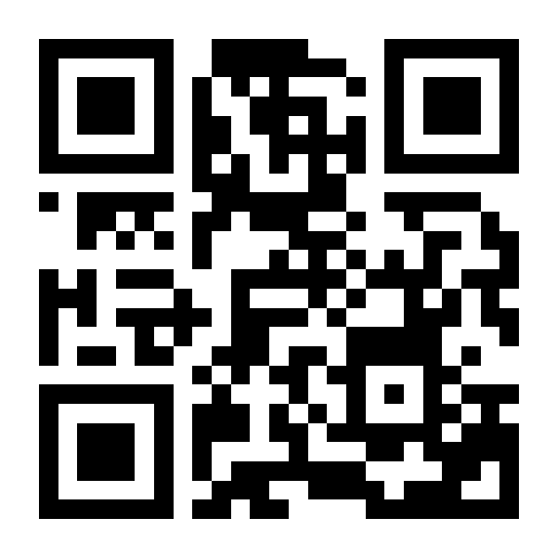
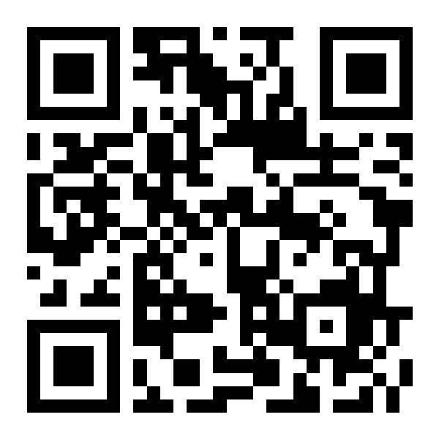
THANK YOU!
Zhimin’s Homepage
Project Page
zhiminfan2002@gmail.com

